Slide 1
MSRC 분석
김서진

Slide 2
MSRC data center traces
Traced 13 core servers for 1 week
- File servers, DBMS, web server, web cache ,…
- 36 volumes, 179 disks
- Per-volume, per-request tracing
Block-level, below buffer cache Typical of small/medium enterprise DC
- Serves one building, ~100 users
- Captures daily/weekly usage patterns

Slide 3
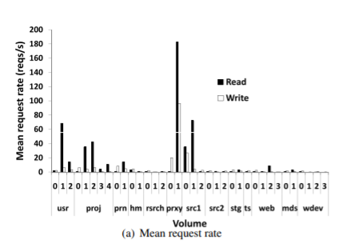
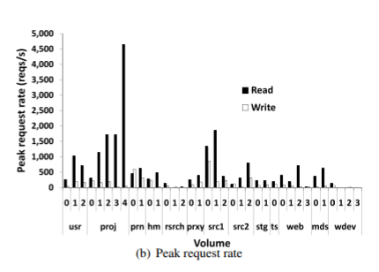
Mean and peak request rates per volume over 7 days
Significant variation
Many volumes have low read and write
Volumes may be provisioned for a high peak load,
Most of the bandwidth is unused most of the time.

Slide 4
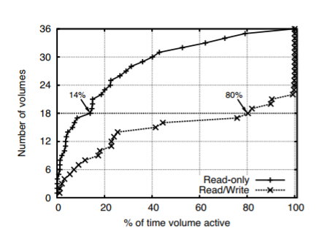
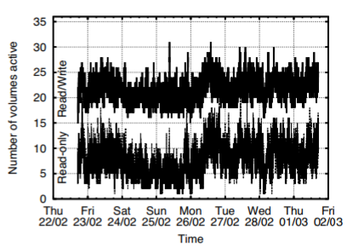
CDF of active time per volume
Cumulative Distribution Function across volumes of the number of volumes versus the percentage of time that the volume is active over the course of a week
Overall, the workload is read-dominated.
Original trace
writes removed: reduced the number of active volumes

Slide 5
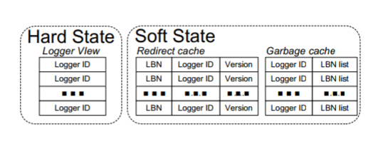
Write Off-Loading: managers
One manager per volume
Intercepts all block-level requests
Spins volume up/down
Home volumes: Off-loads writes when spun down
Probes logger view to find least-loaded logger
Spins up on read miss
Reclaims off-loaded data lazily

Slide 6
Write off-loading: loggers
Reliable, write-optimized, short-term store
- Circular log structure
Uses a small amount of storage
- Unused space at end of volume, flash device
Stores data off-loaded by managers
- Includes version, manager ID, LBN range
- Until reclaimed by manager
Not meant for long-term storage

Slide 7
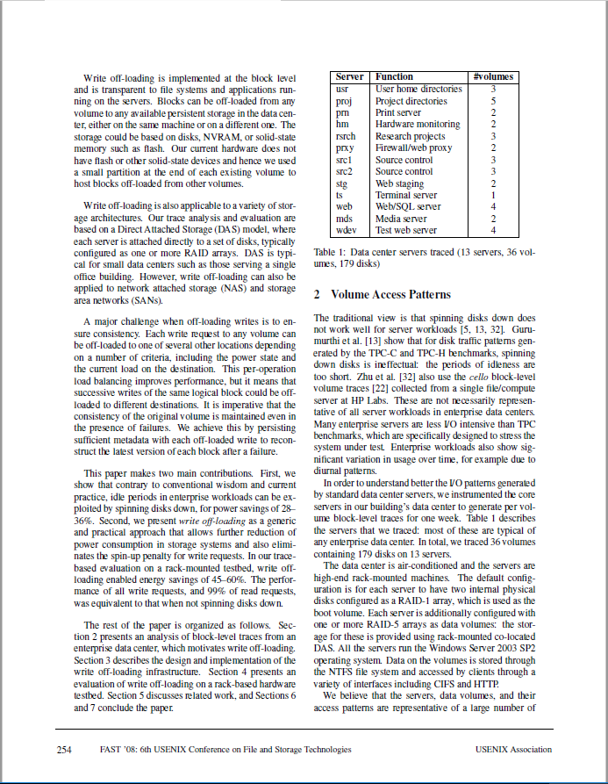
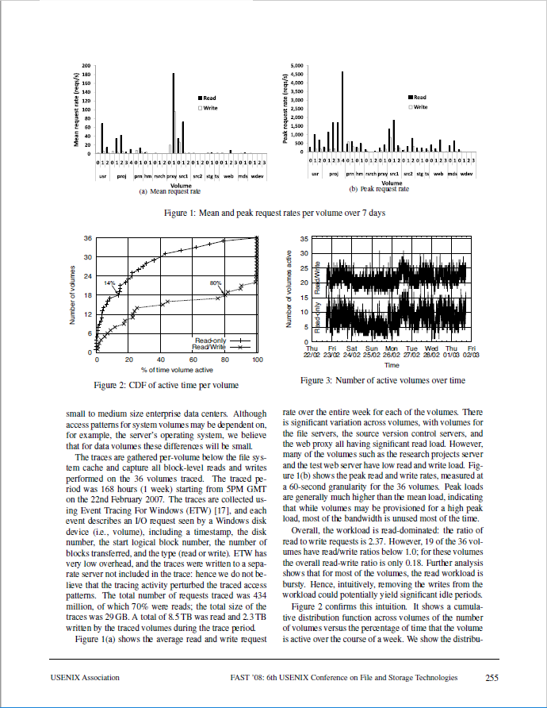
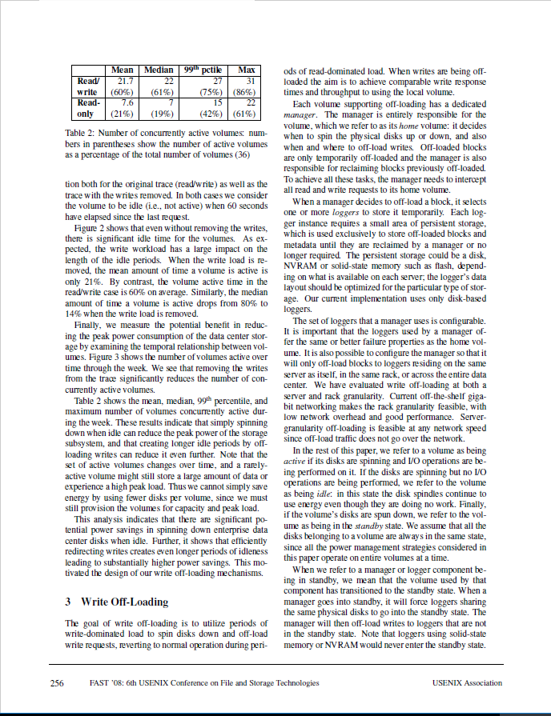
읽은 논문 page
Write-off loading: Practical power Management for Enterprise Storage (FAST’08)
2.Volume access pattern 254p~256p

